Slide 1
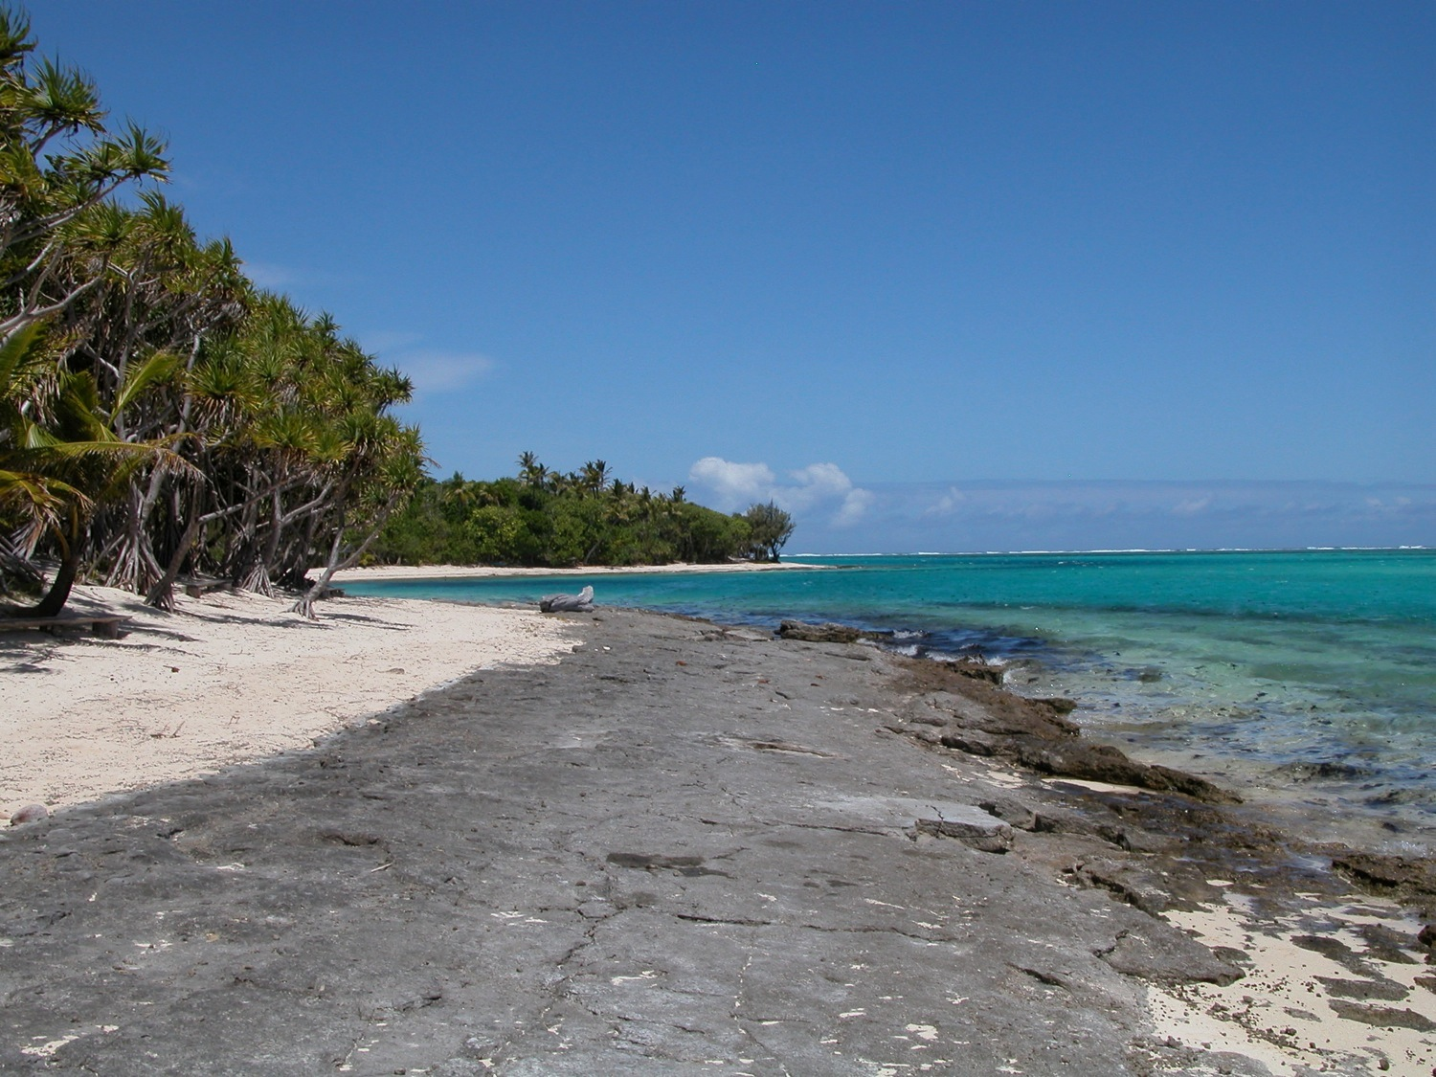



Plants & People
of
Tafea Province, Vanuatu
A Partnership between:
New York Botanical Garden
University of Hawai’i
University of the South Pacific
Tafea Kaljoral Senta
Vanuatu Department of Forestry
Vanuatu Ministry of Health
Funded by:

Slide 2
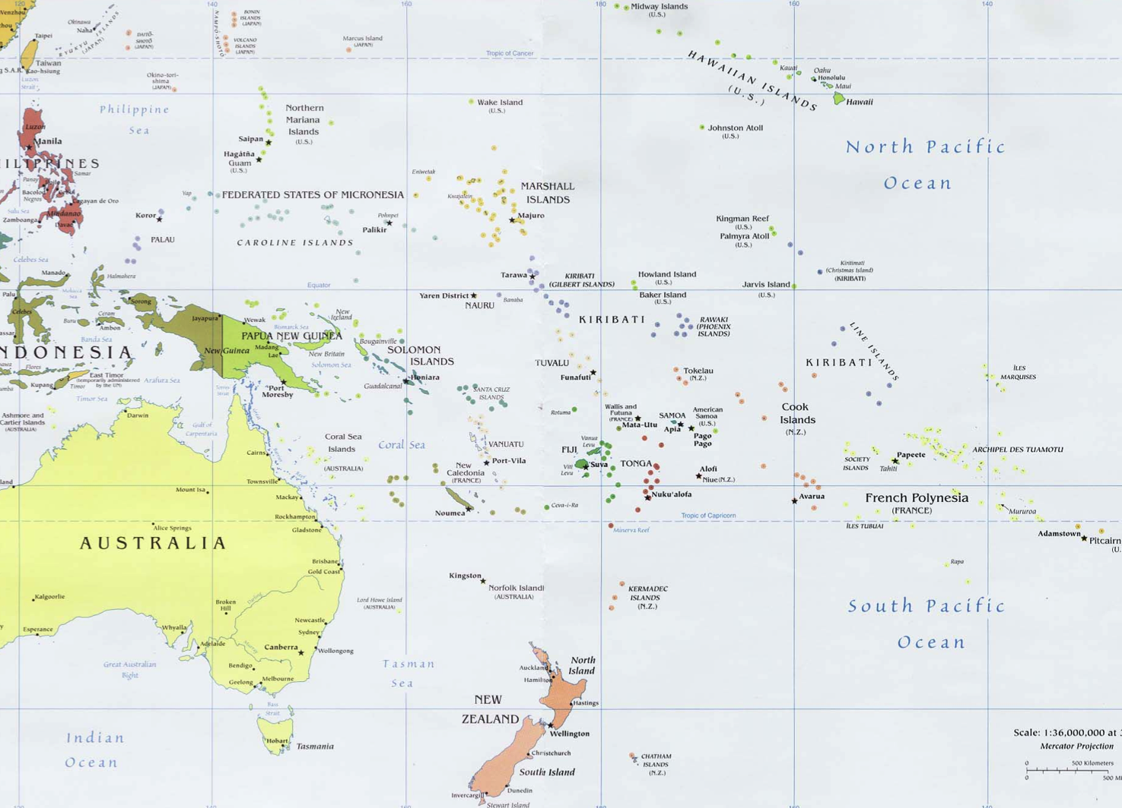
Micronesia
Solomon
Islands
Vanuatu
Polynesia
Melanesia
New
Caledonia
Fiji

Slide 3

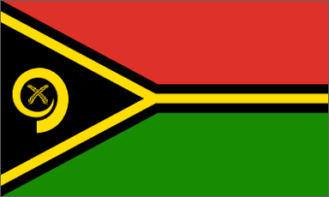
Republic of Vanuatu
(Ripablik blong Vanuatu)
Total Population: 230,000
Total Land Area: 12,200 km² [~Connecticut]
No. Islands: 80 (65 inhabited)
Total Ppt. (wet sides) 160 in./year
Highest Point: Tabwemasana 1,877 m (6,156 ft)
(on Espiritu Santo Is.)
Capital City: Port-Vila, Efaté Is. (pop. 36,000)

Slide 4
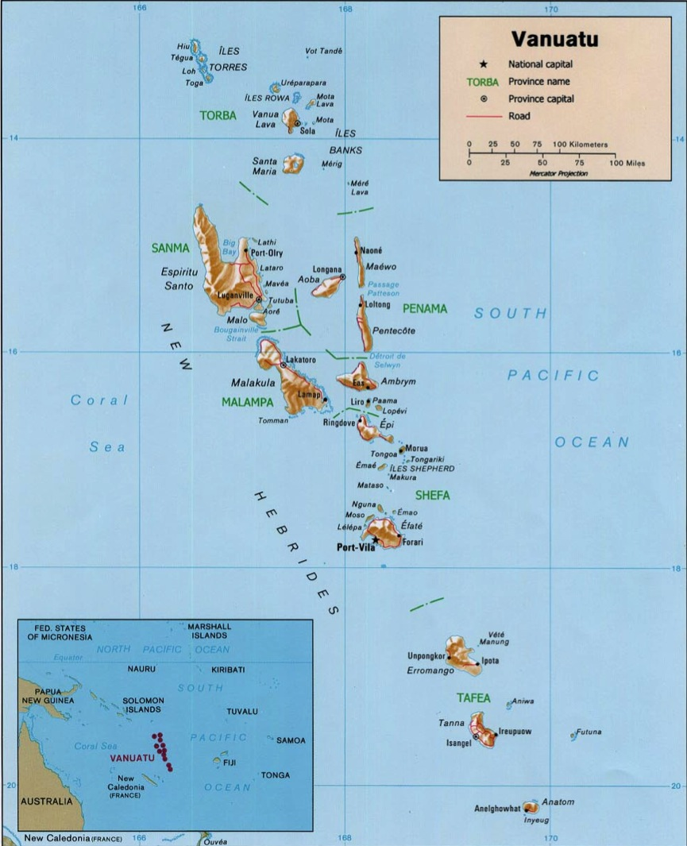
Santo 2006
Efaté
T-anna
A-neityum
F-utuna
E-rromango
A-niwa
Tafea Prov.

Slide 5
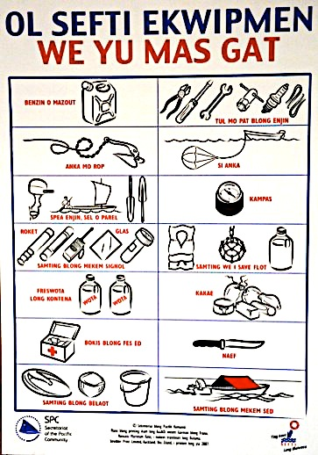
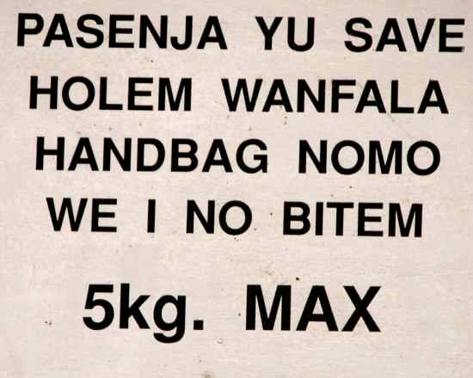
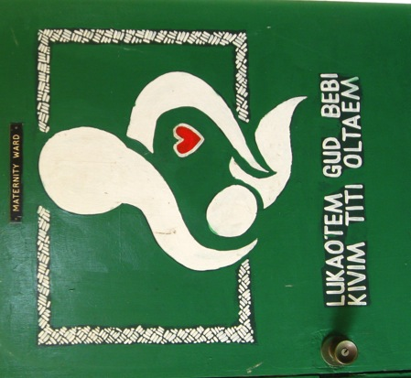
Vanuatu: Brief History & Culture
Ethnic Groups: 98% Melanesian (Ni-Vanuatu)
Colonial Period: “New Hebrides” (1906 – 1980)
British–French Condominium
No. languages: 112 local languages
+ French, English, Bislama

Slide 6

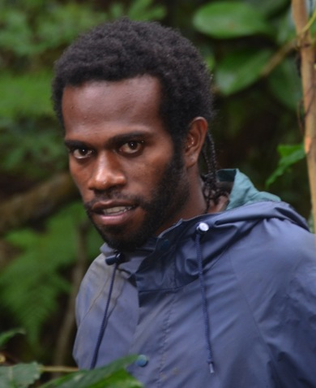
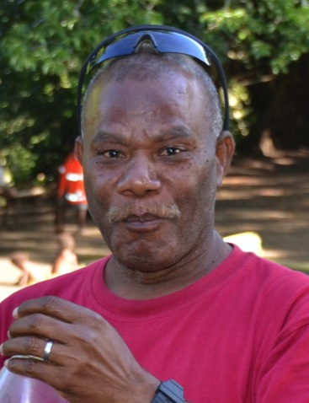
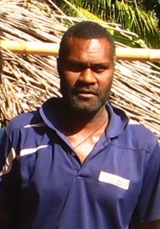
1. Who are we?
Tafea Kaljoral Senta
Jean-Pascal Wahe
Jacob Kapere
Sam Herwaen

Slide 7
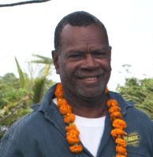
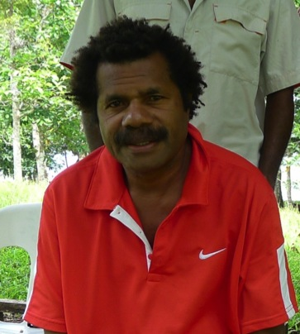
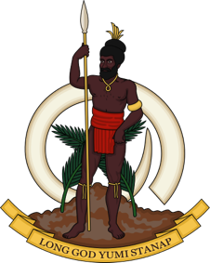
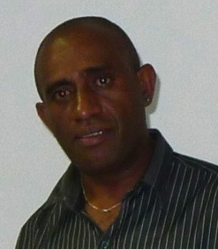
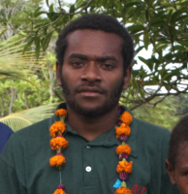
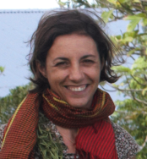
Vanuatu Dept.
of Forestry
Chanel Sam
Philemon Ala
Presley Dovo
Frazer Alo
Laurence Ramon

Slide 8
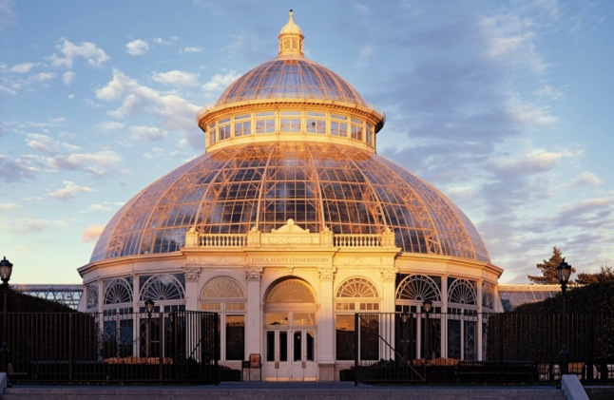
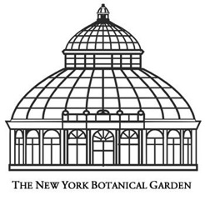
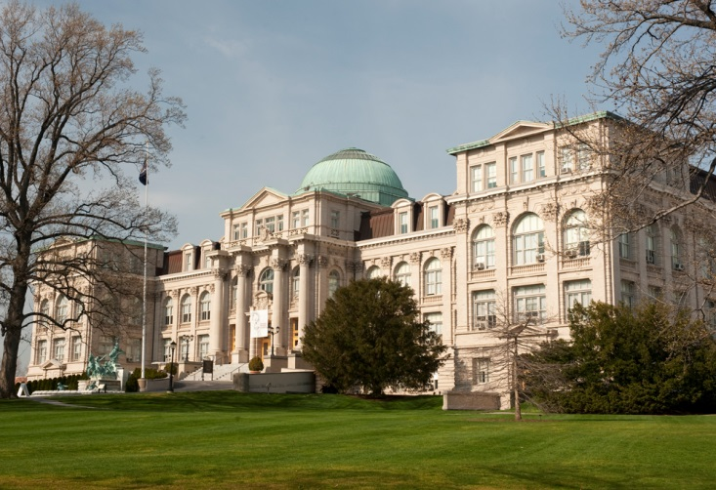
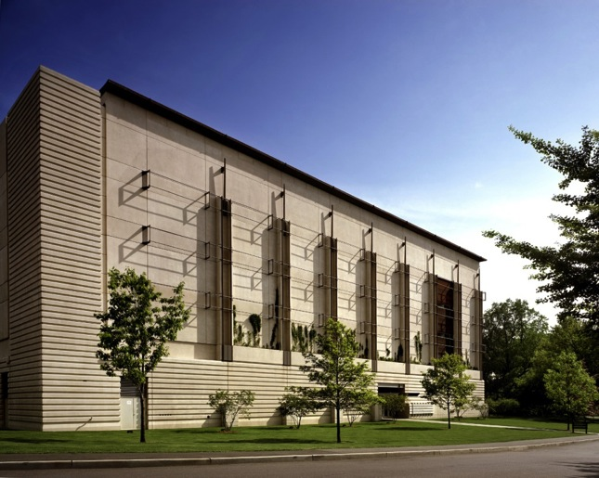
New York Botanical Garden
New York City, USA
Conservatory
Museum Building
Herbarium

Slide 9

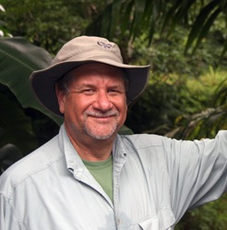
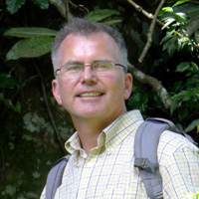
NYBG
Principle Investigators
Dr. Mike Balick
Dr. Greg Plunkett

Slide 10
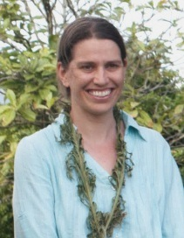
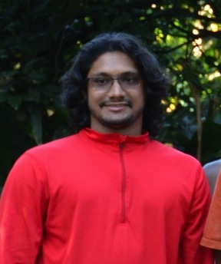
NYBG
Other Investigators
Dr. Kate Armstrong
Sean Thackurdeen

Slide 11
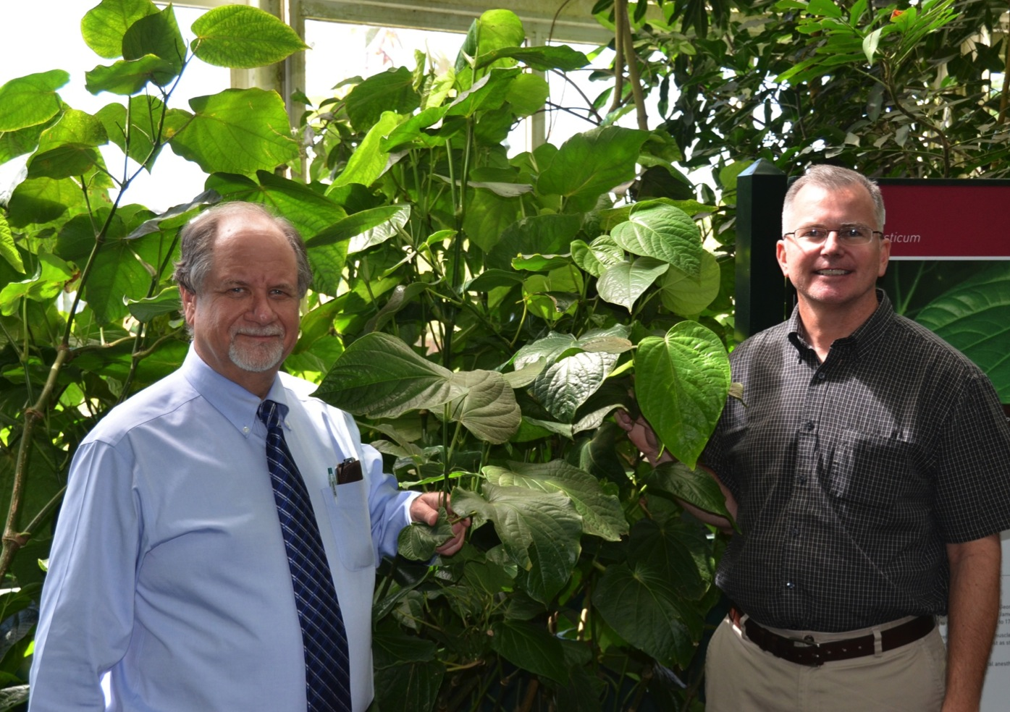
Kava growing in NYBG Conservatory
Herbarium

Slide 12
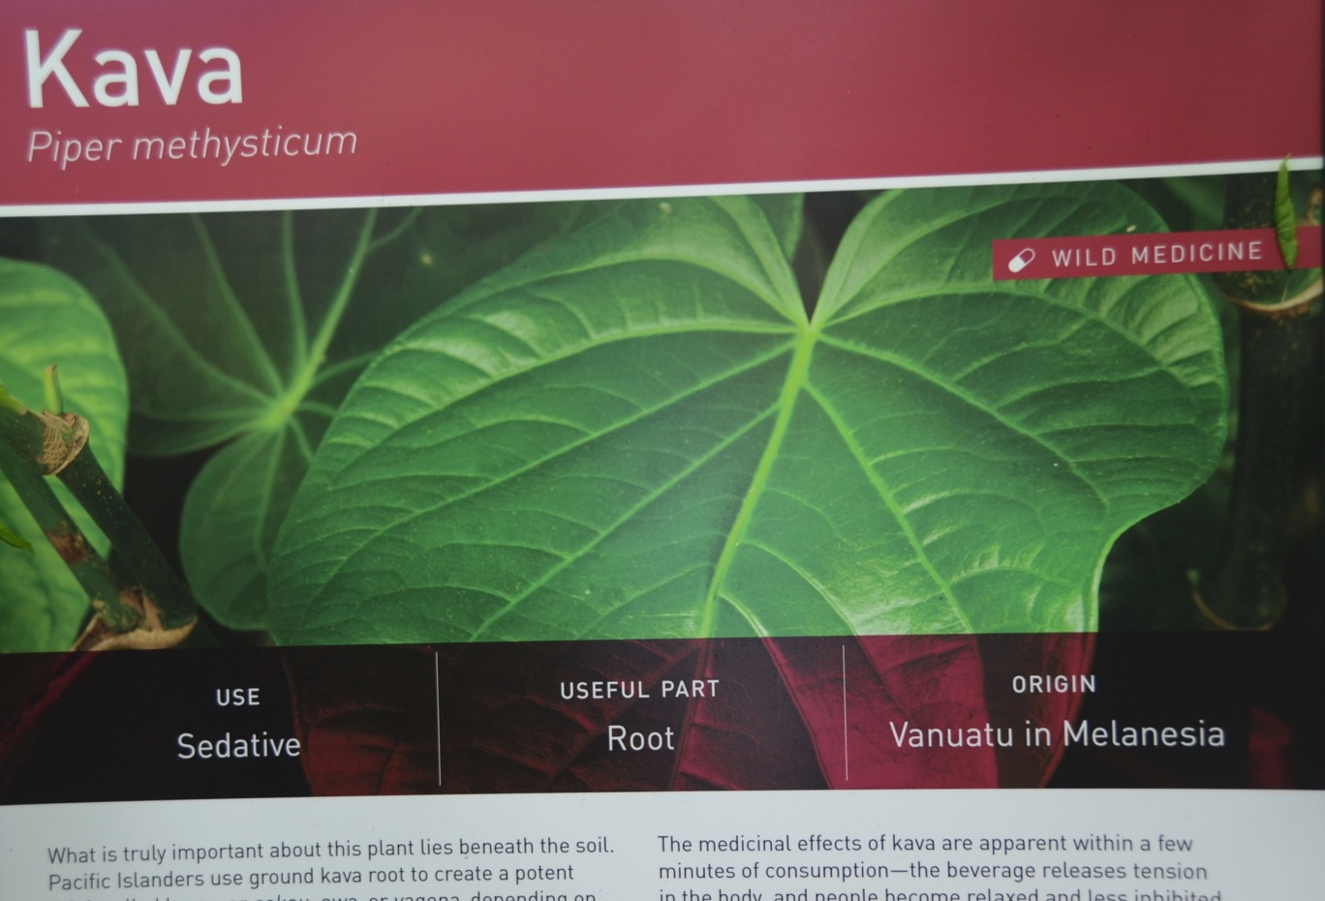
Kava growing in NYBG Conservatory

Slide 13

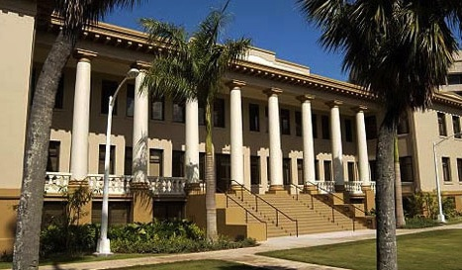
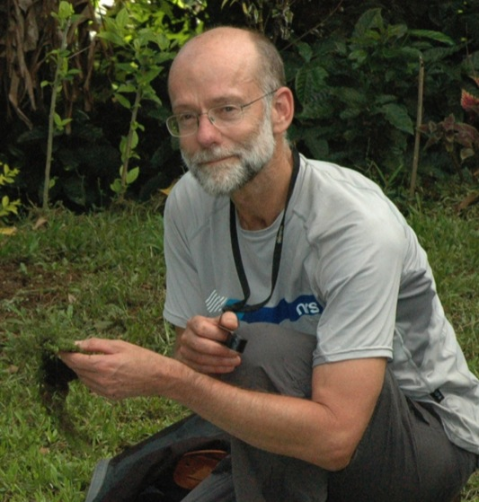
Dr. Tom Ranker

Slide 14

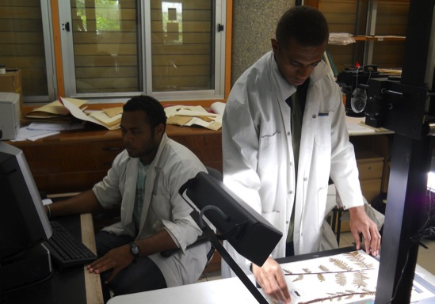
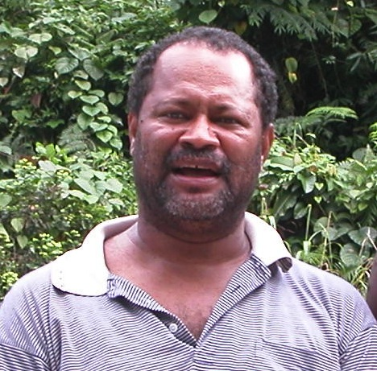
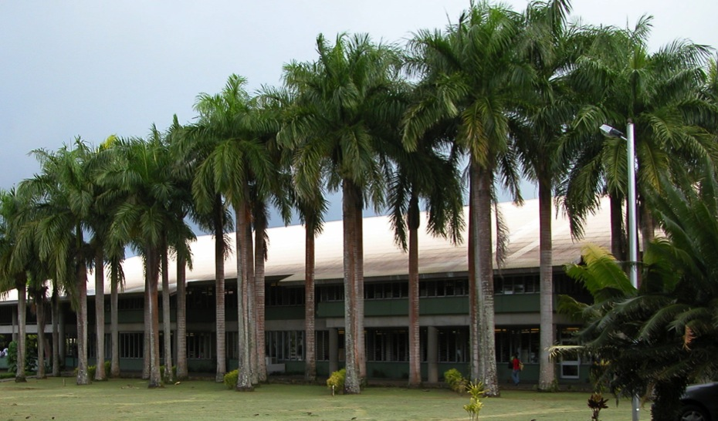
University of the South Pacific
Suva, Fiji
South Pacific
Regional Herbarium
Marika Tuiwawa

Slide 15
2. What are we doing here?
2 Main Goals:
We are all working together to help:
1. Document all plants
of Tafea Province
2. Document local names &
general uses of plants

Slide 16
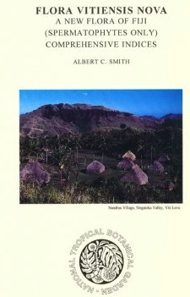
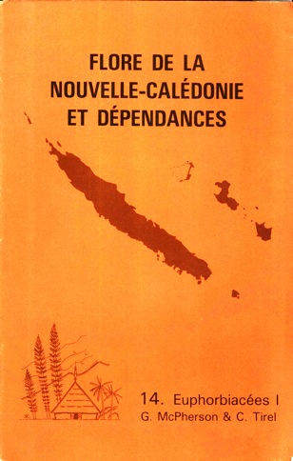
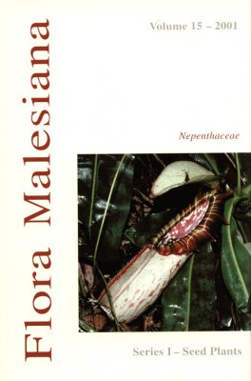


1. Document all plants of Tafea Province
Most Pacific Islands
have full surveys
& lists of all plants:
Flora of
Vanuatu
???
(i no kat)
Fiji
New Caledonia
PNG
Hawaii
New Zealand
We will start this
effort for Vanuatu
by documenting
plants from Tafea

Slide 17
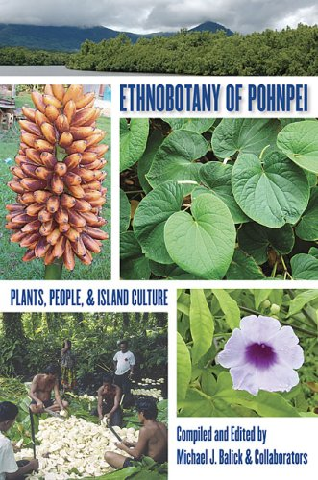
2. Document local names & general uses
of plants
Interview people to
document how Ni-Vanuatu
use plants for:
Food
Building houses
Building canoes
Traditional clothing
Primary health
Only general knowledge
(not family secrets)
Similar Project in Fed. States of Micronesia

Slide 18
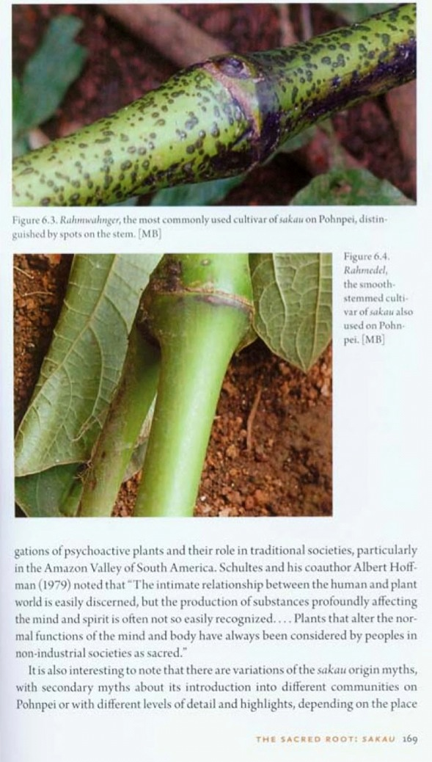
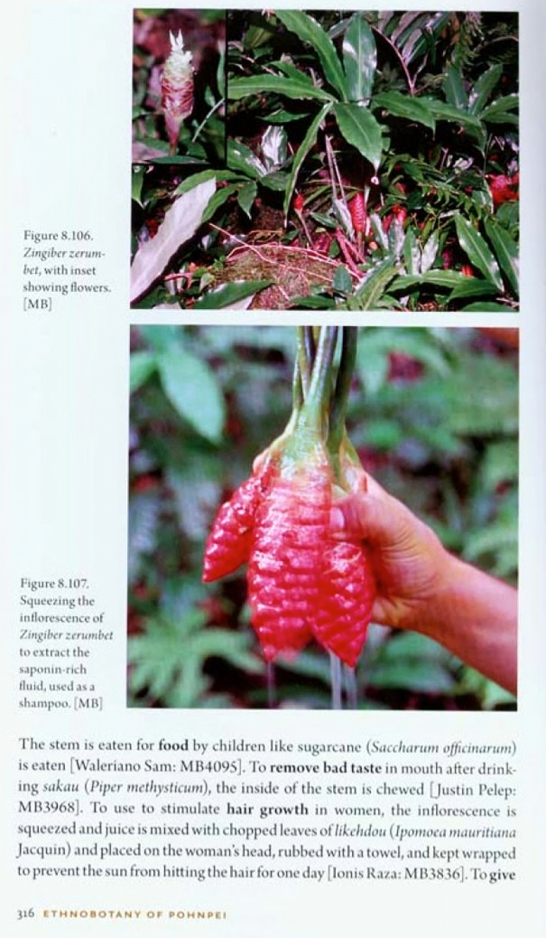
Examples
of pages
from
ethnobotany
book

Slide 19
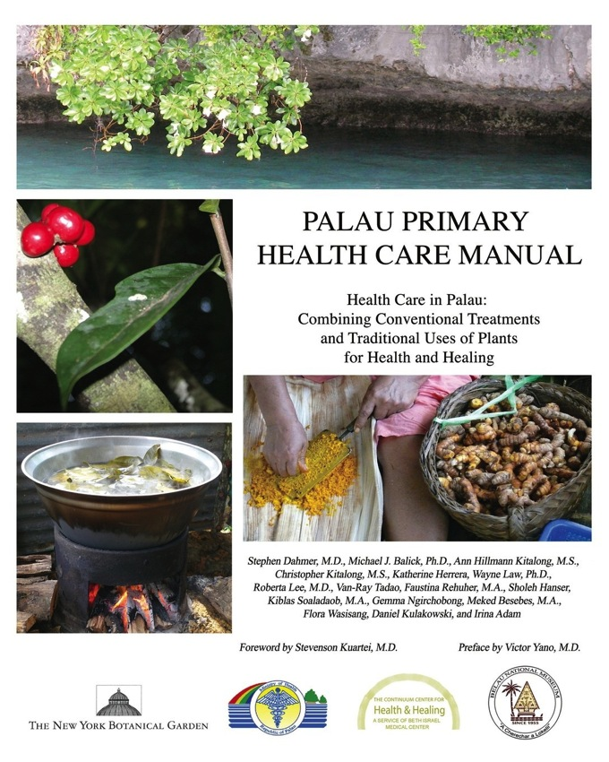
Also create a “Primary Health Care” Manual
Basic health care for:
Skin problems
Cuts, scrapes, bruises
Bites & stings
Colds & flu
Head ache
Stress & pain
Stomach ache
Diarrhoea
Men’s health
Women’s health
Only general knowledge
(not family secrets)

Slide 20
Why document general knowledge if
everyone already knows it?
General knowledge passed down from
grandparents & parents to children
But today, sometimes this knowledge is lost
(current generation knows less than their
grandparents)
Documenting general knowledge preserves it
for the future, and helps to establish it as yours

Slide 21
Work so far:
Organizational & community awareness:
February-March 2013: Vila, Tanna, Erromango
Sept-October 2013: Vila, Tanna, Aneityum
Plant Diversity & Ethnobotanical Data Collections:
June 2014: Tanna
November 2014: Tanna
Letakran Village & Bush
Mount Lowanialu Forest
Yakel Village & Bush
Lowkwaria Village & Bush
Green Hill Botanical Garden & Conservation Area
Bush near Yasur
Yenhup Village & Bush, & Forest near Tukosmera
Iatukei Village & Bush

Slide 22
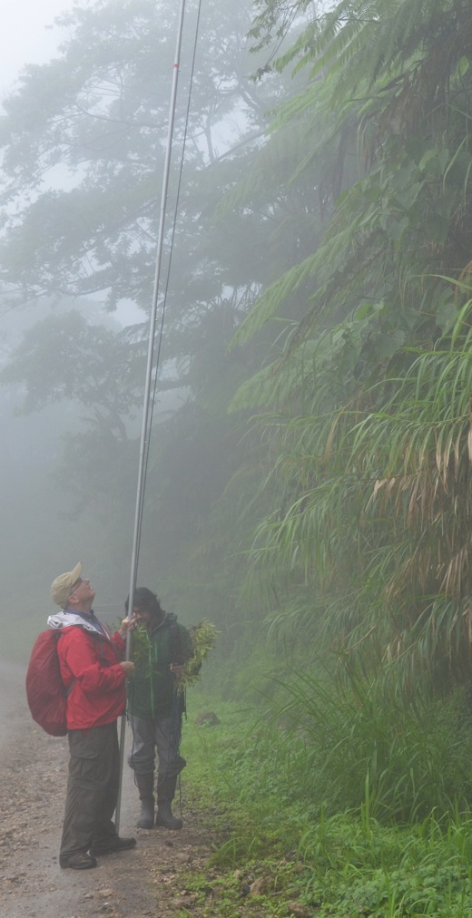
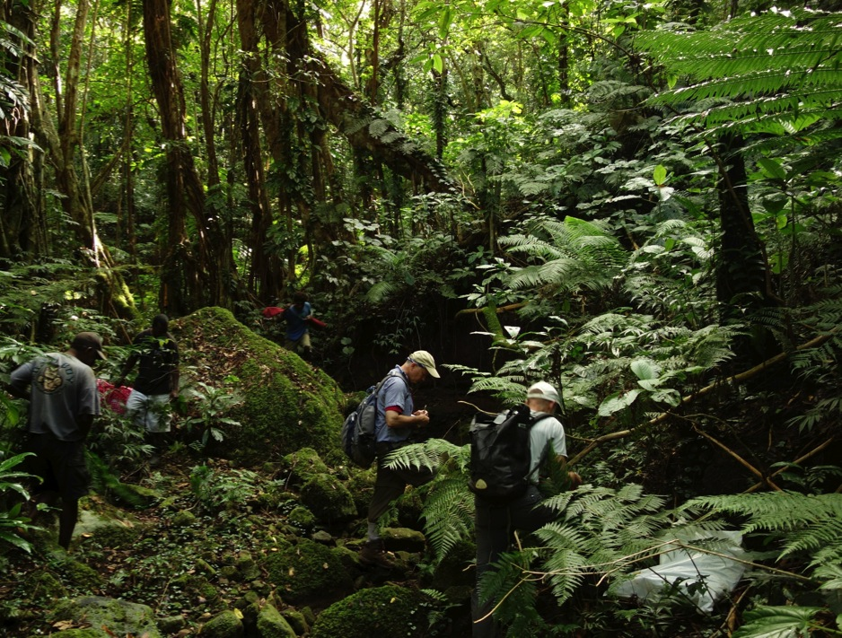
Collecting Plants

Slide 23
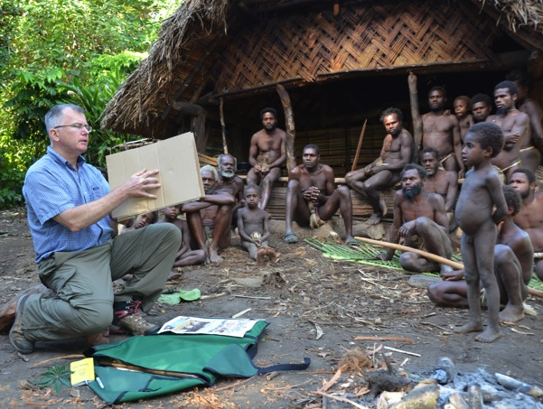
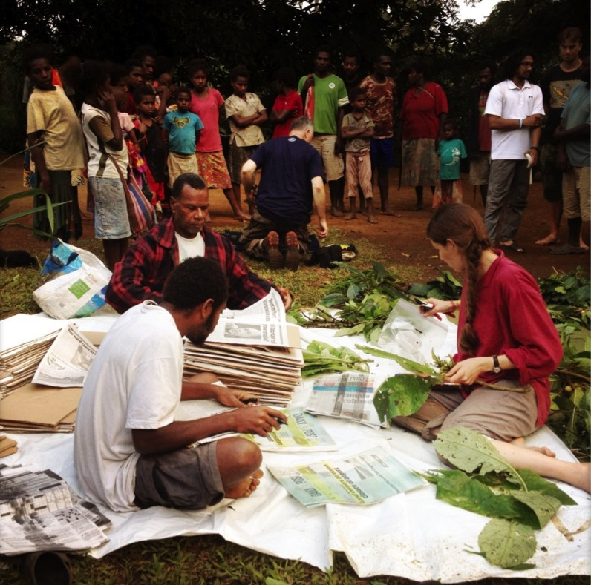
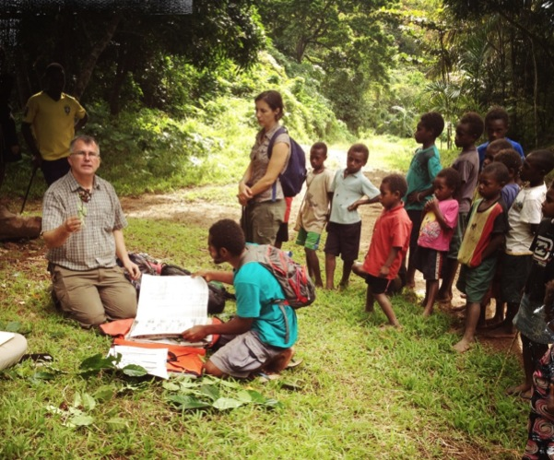
Pressing Plants for
Permanent Specimens

Slide 24
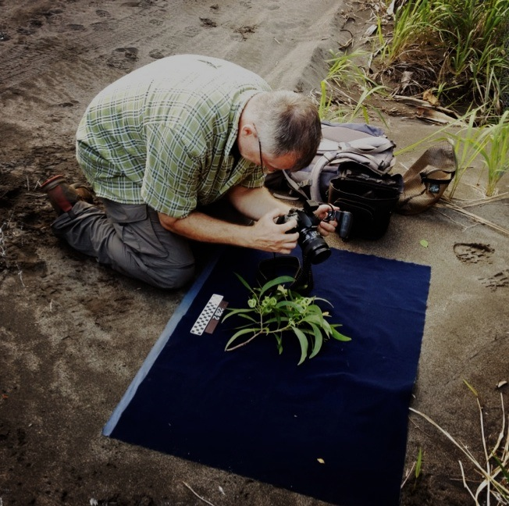
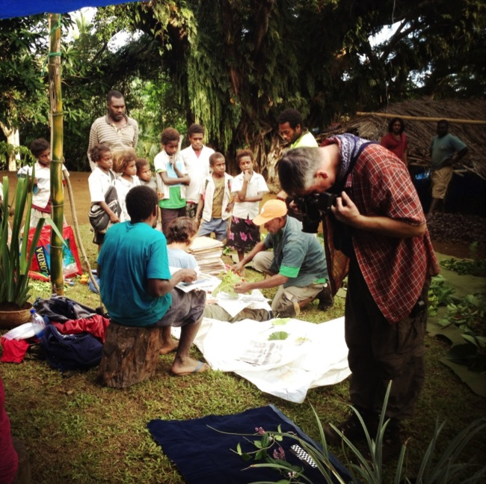
Photographing each plant

Slide 25
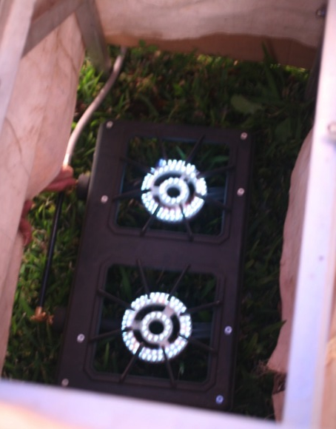
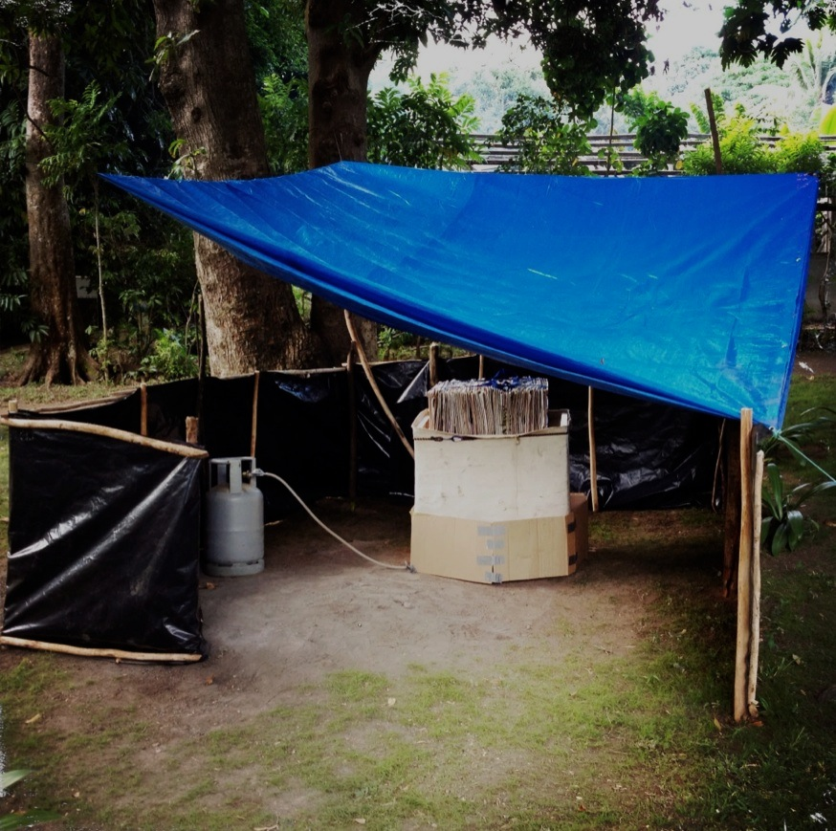
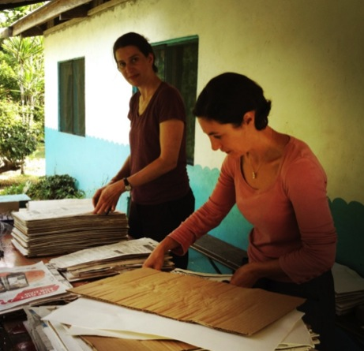
Drying Pressed Plants

Slide 26
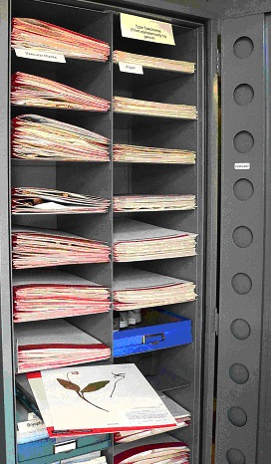
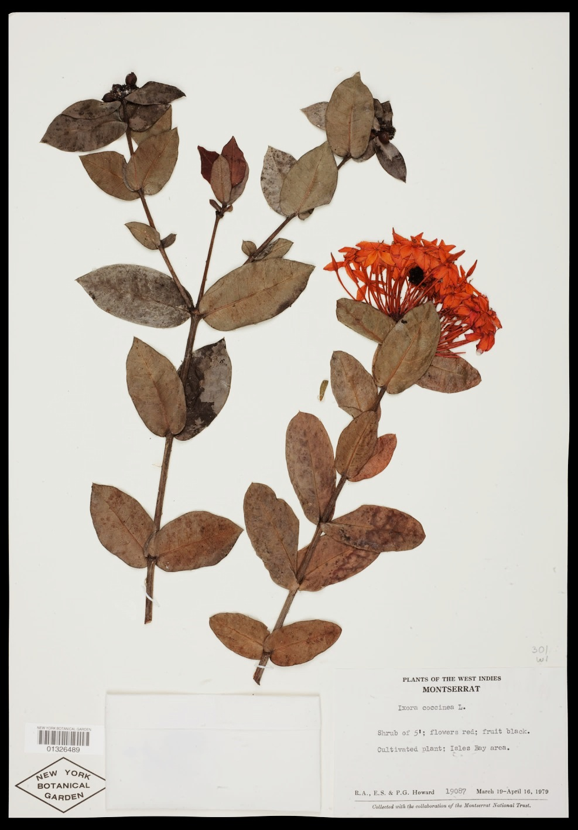
Preserved Specimens
Stored in Herbarium

Slide 27


Ethnobotanical
Interviews

Slide 28


Uses of Plants: Examples
“Nimto” (blakpam) used
to make laplap
Cyathea sp.
(Cyatheaceae)

Slide 29


Dysoxylum aneityense
(Meliaceae)
“Tuai” (stinkwud) used
to make a bow

Slide 30



Burckella vitiensis
(Sapotaceae)
“Kuaniere” used in applying tattoos
(white exudate from fruit placed over a fresh needle-drawn tattoo;
charcoal then applied as the coloring agent, binding to the white exudate)

Slide 31



“Namha” (huremi, waetwood)
used to treat urinary-track
infections in men
used to make a “bush soap”
Alphitonia zizyphoides
(Rhamnaceae)

Slide 32

Garcinia pseudoguttifera
(Clusiaceae)
“Kuankiriage”
latex used to treat wounds
(exudate from lower trunk used as a paste to fill cuts and sores)
as a chewing gum

Slide 33

Skin (bark) of rop (vine)
used to braid hair

Slide 34

Field Sites
Green Hill &
Nusemetu
Tanna
White Grass Airport
Lowkwaria
Mt Lowanialu
Letakran
Mt Yasur
Yakel
Lenakel
Mt Yasur
Mt Tukosmera
Iatukei
Yenhup &
Yenasur
Mt Malen

Slide 35



Lowkwaria

Slide 36



Letakran

Slide 37




Mt Lowanialu

Slide 38





Slide 39



Yakel Village & Bush

Slide 40




Slide 41

Green Hill Botanical Garden
& Nusametu Conservation Area

Slide 42


Ex situ conservation of Nohoich pamtri
(Carpoxylon macrocarpum),
Vanuatu’s only endemic plant genus
One of last remaining signs at Green Hill Botanical Garden

Slide 43




Nusemetu Conservation Area

Slide 44




Forging partnerships
Teaching the Next Generation
Building Relationships
Respecting Traditions

Slide 45




Bush near Yasur

Slide 46




Yenhup Village & Tukosmera Area
Mt Tukosmera
Yenhup Nakamal & Chiefs
Ax-carving
stone
Stone of
Drae Wud

Slide 47




Cyclone house
Host family in Yenhup
Kastom dance
in Inemra
“Telephone tree”

Slide 48



Participation of Yenhup Village
in collecting & identifying plants

Slide 49




Slide 50




Iatukei Area
Lowland forest
at SE Tanna
Mt Tukosmera
Iatukei Medical Aidpost

Slide 51




Smol Toktok at Iandarara Nakamal
Preparing Kava...
Explaining preliminary reports to chiefs
...Sharing Kava

Slide 52





Education & Outreach to Local Schools & Community Groups
Seminar to Lenakel Presbyterian College
Presentation to Harbour View School
Outreach to Erromango Community Leaders
Outreach to Tanna Council of Chiefs

Slide 53

Long-term Goal:
Tafea,
Vanuatu
Tafea, Vanuatu
…for the people of Tafea Province

Slide 54

Tankyu Tumas!

